Slide 1
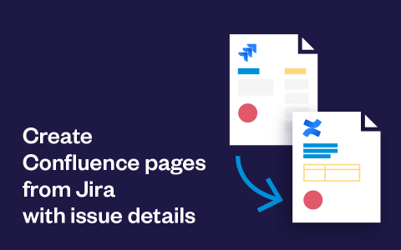
On the Marketplace
Jira Cloud
Key features
Create Confluence pages from any Jira issue: JSM, Software, JWM
Link Confluence pages and Jira issues
Use Confluence templates or design your own page with in-app editor
Insert Jira field values, attachments, and labels into Confluence pages
Pre-select space and parent page in Confluence
Create page manually, or automatically during transition
Control where and by who, the creation can be triggered
Update pages when Jira issue fields are changed
Configuring this app
Use cases
Bug analysis
Post-mortems
Knowledge base articles
User story details
Release details
Employee onboarding
Demo video
Getting-started guide
Cécile - Partner Manager
cecile.sablayrolles@elements-apps.com
Walk through
Documentation
Technical Support

